Slide 1
Lincoln Community Larder Helping local people in crisis
Harvest Festival
a time to think of others

Slide 2
This is our logo, the badge of the larder
Why do you think we chose it?
What do you think it stands for?

Slide 3
5 loaves and 2 fishes
It’s the story of a little boy who gave his picnic lunch to share with other people who had no food

Slide 4
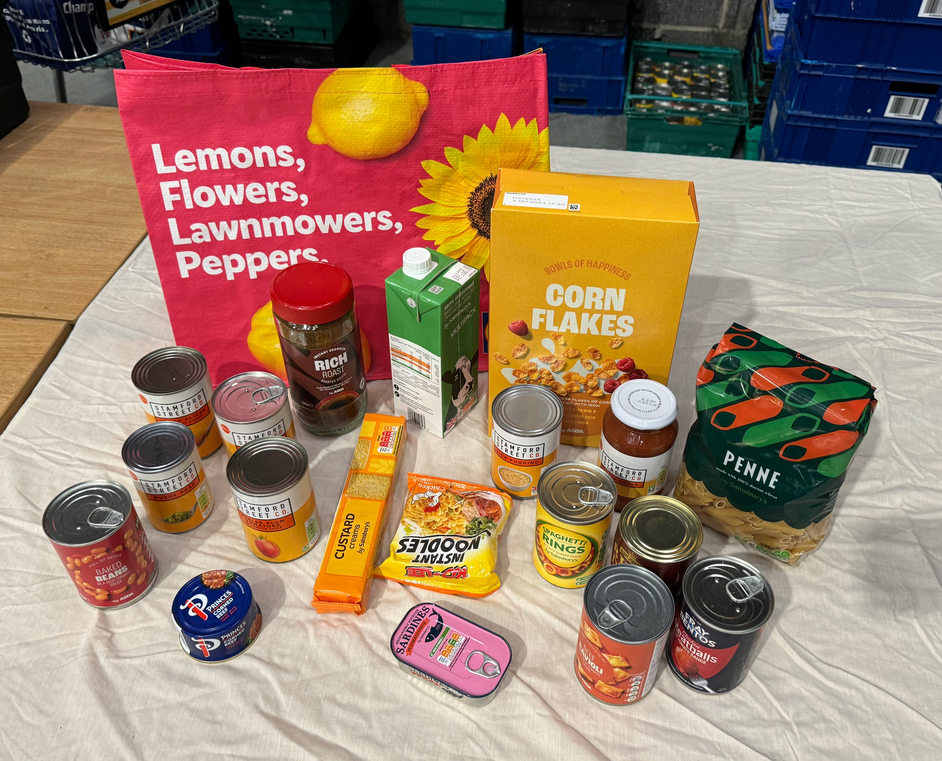
What words can we make from the word
HARVEST?

Slide 5
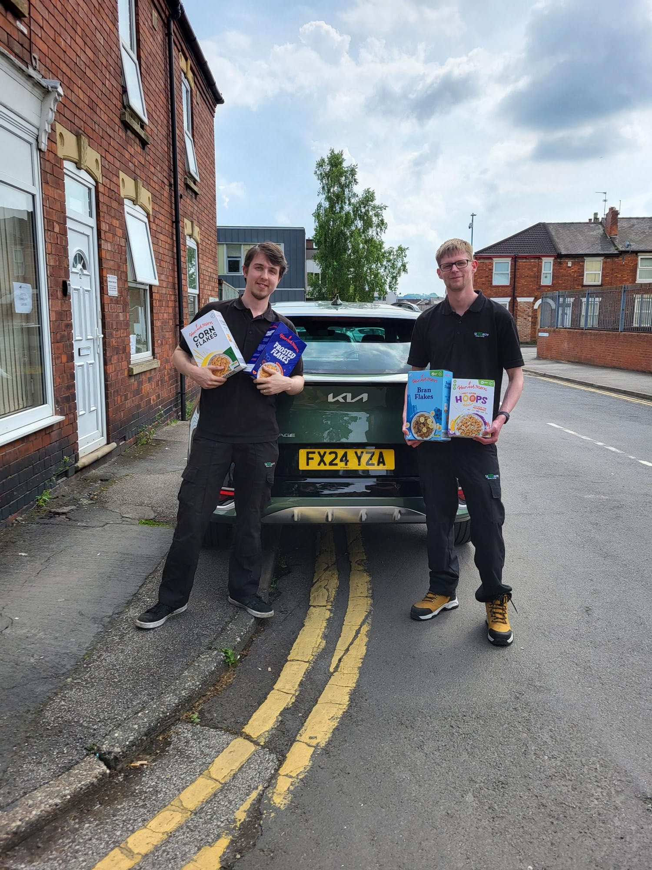
We could make
STARVE or SHARE?
Should we share what we have with people in need?

Slide 6
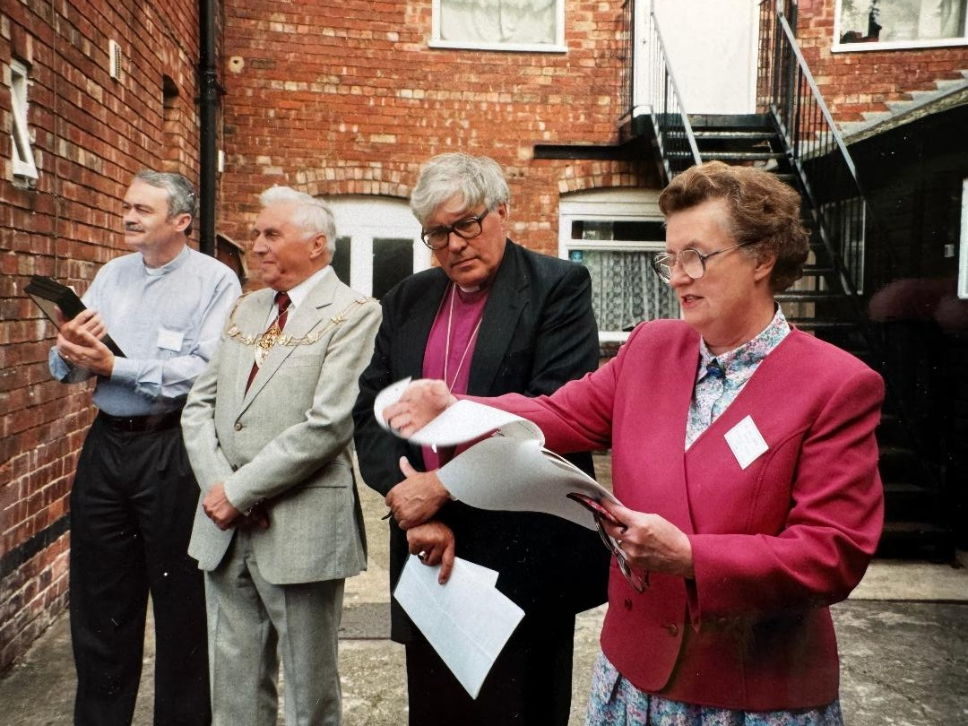
Can we share our story with you?
Mary Eckmyre lived on Monks Road and 35years ago became aware that families in the area were struggling. On August 18th 1989 she started helping people from her own front room. People found out about this help through word of mouth and soon she couldn't meet their needs from her small front room.
Mary then involved local churches and the YMCA to meet the ever increasing demands.
Mary and the Bishop of Lincoln at the official opening
of the Rosemary Lane Larder

Slide 7
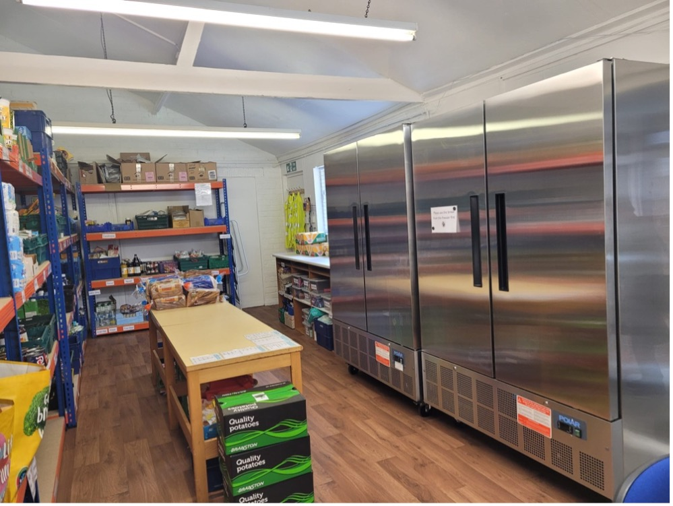
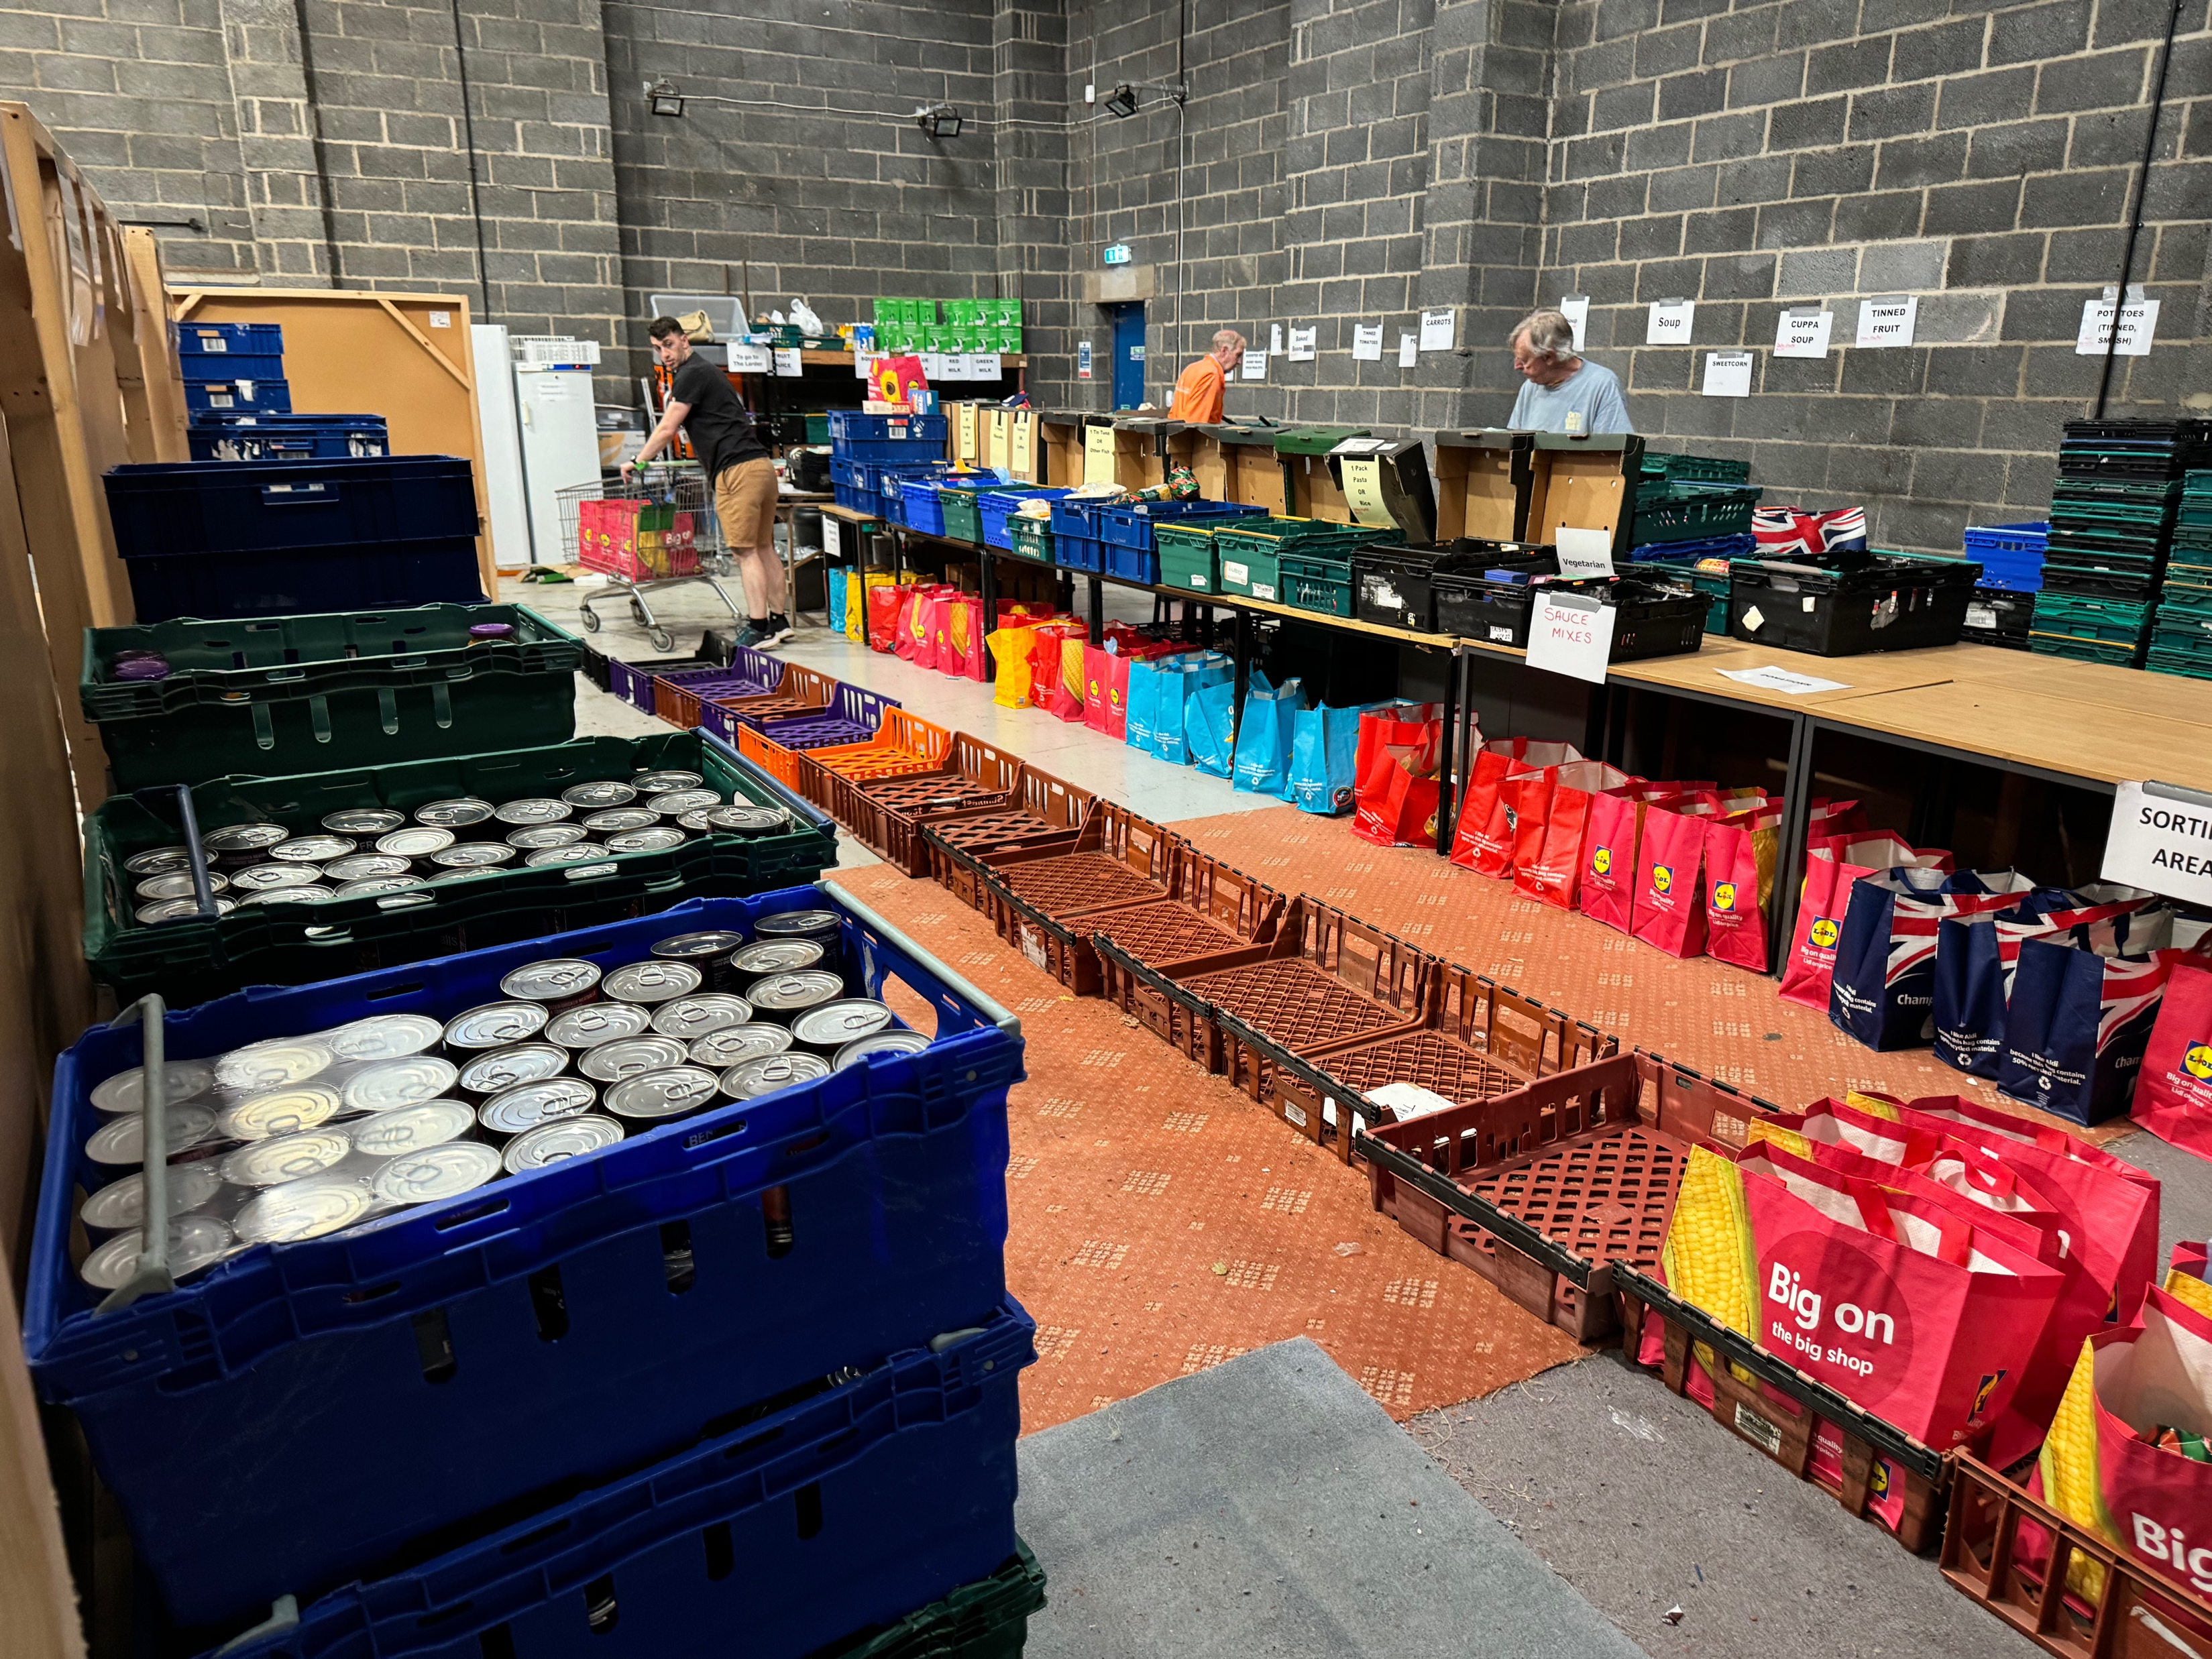
We are now a much more complex organisation with outreaches not only at Rosemary Lane in Lincoln (but also on the Ermine Estate the St Giles Estate , Welton/Dunholme, Wragby and Martin villages.
We have 55 volunteers working in different ways to help and no one is paid.
We have a warehouse to store the food we receive as donations and to store the food we have to buy to meet our needs.
Last year we fed approximately 5000 people in Lincoln and the surrounding area, including almost 2000 children.
Our warehouse and Rosemary Lane Larder

Slide 8
What food do we provide?
Pre-packed bags are made up at the warehouse.These contain enough food for three days and provide as much variety and nutritional value as is possible in tins and packets.
Fresh food is also given including cheese, spread, milk, bread (Sainsbury's), eggs (Noble’s Farm at North Scarle) and potatoes (Branston Potatoes) along with some Co-op vouchers to buy fresh fruit and vegetables.
When there are children in a family additional items are provided such as angel delight, jelly, juice, squash, fish/meat paste, crisps and crackers.
If clients have nowhere to live or no cooking facilities we give them a range of foods to meet their needs including meals used by our armed forces when they are on manoeuvres .
A typical pre-packed bag for one person

Slide 9
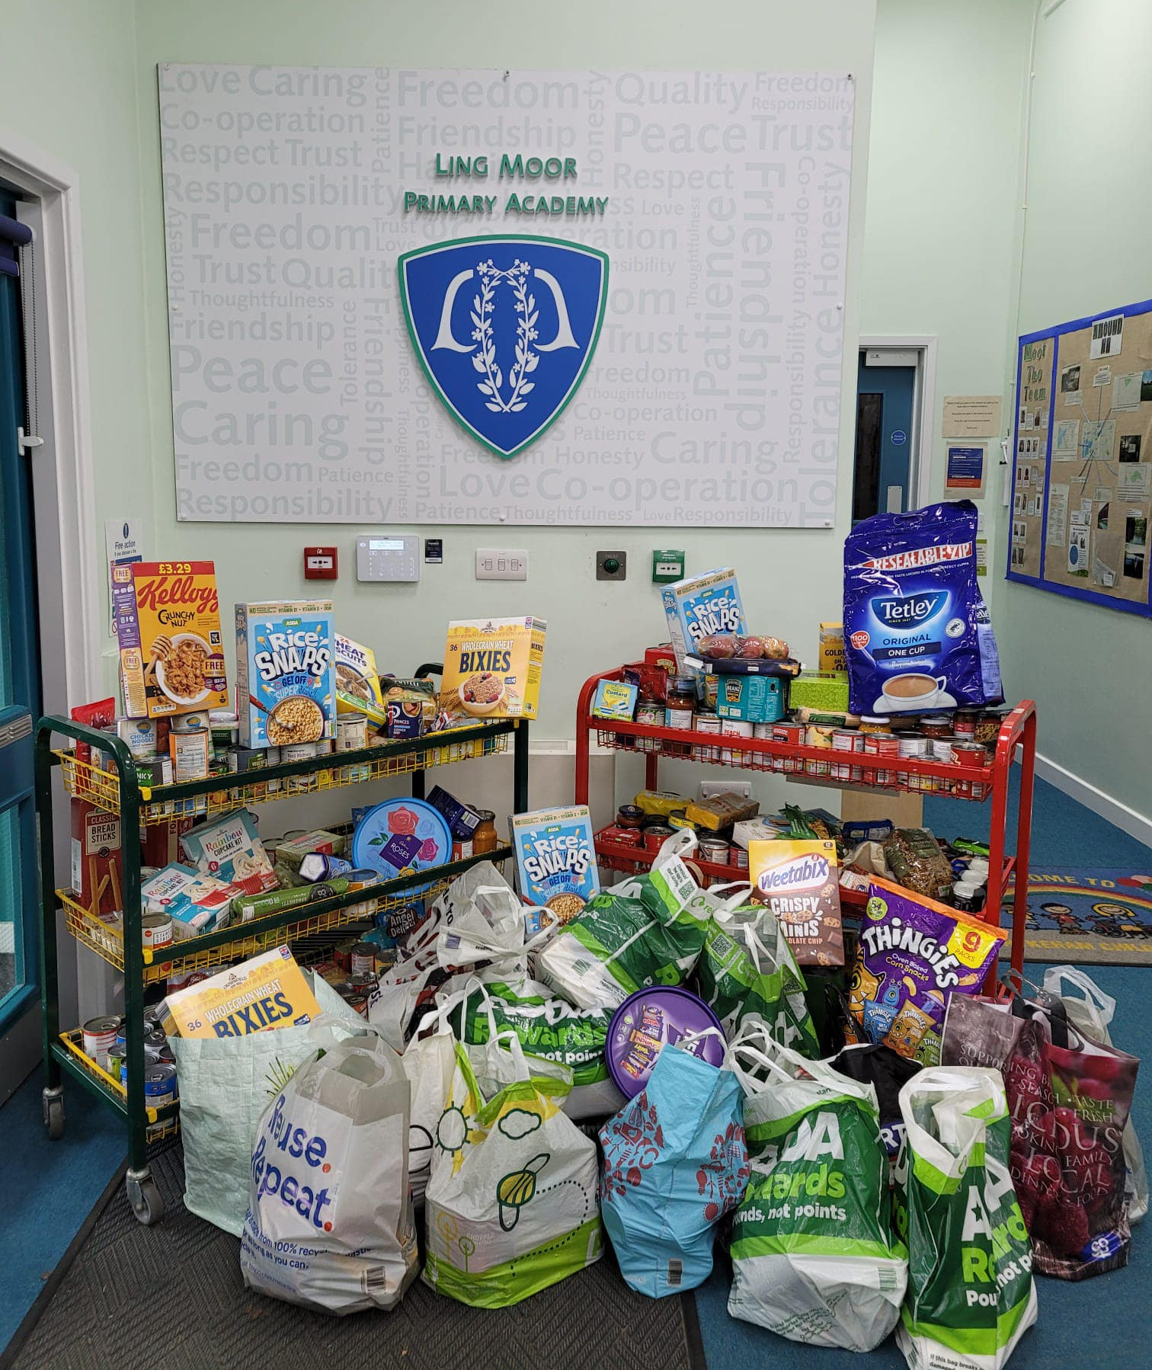
How do we get the food?
Through the year generous people donate food.
Some people help us by donating money for us to buy food.
Some people give up their time to help us as volunteers in our larders and warehouse.
Much of our food is provided by generous harvest donations such as the one you are giving us.
Harvest Donations

Slide 10
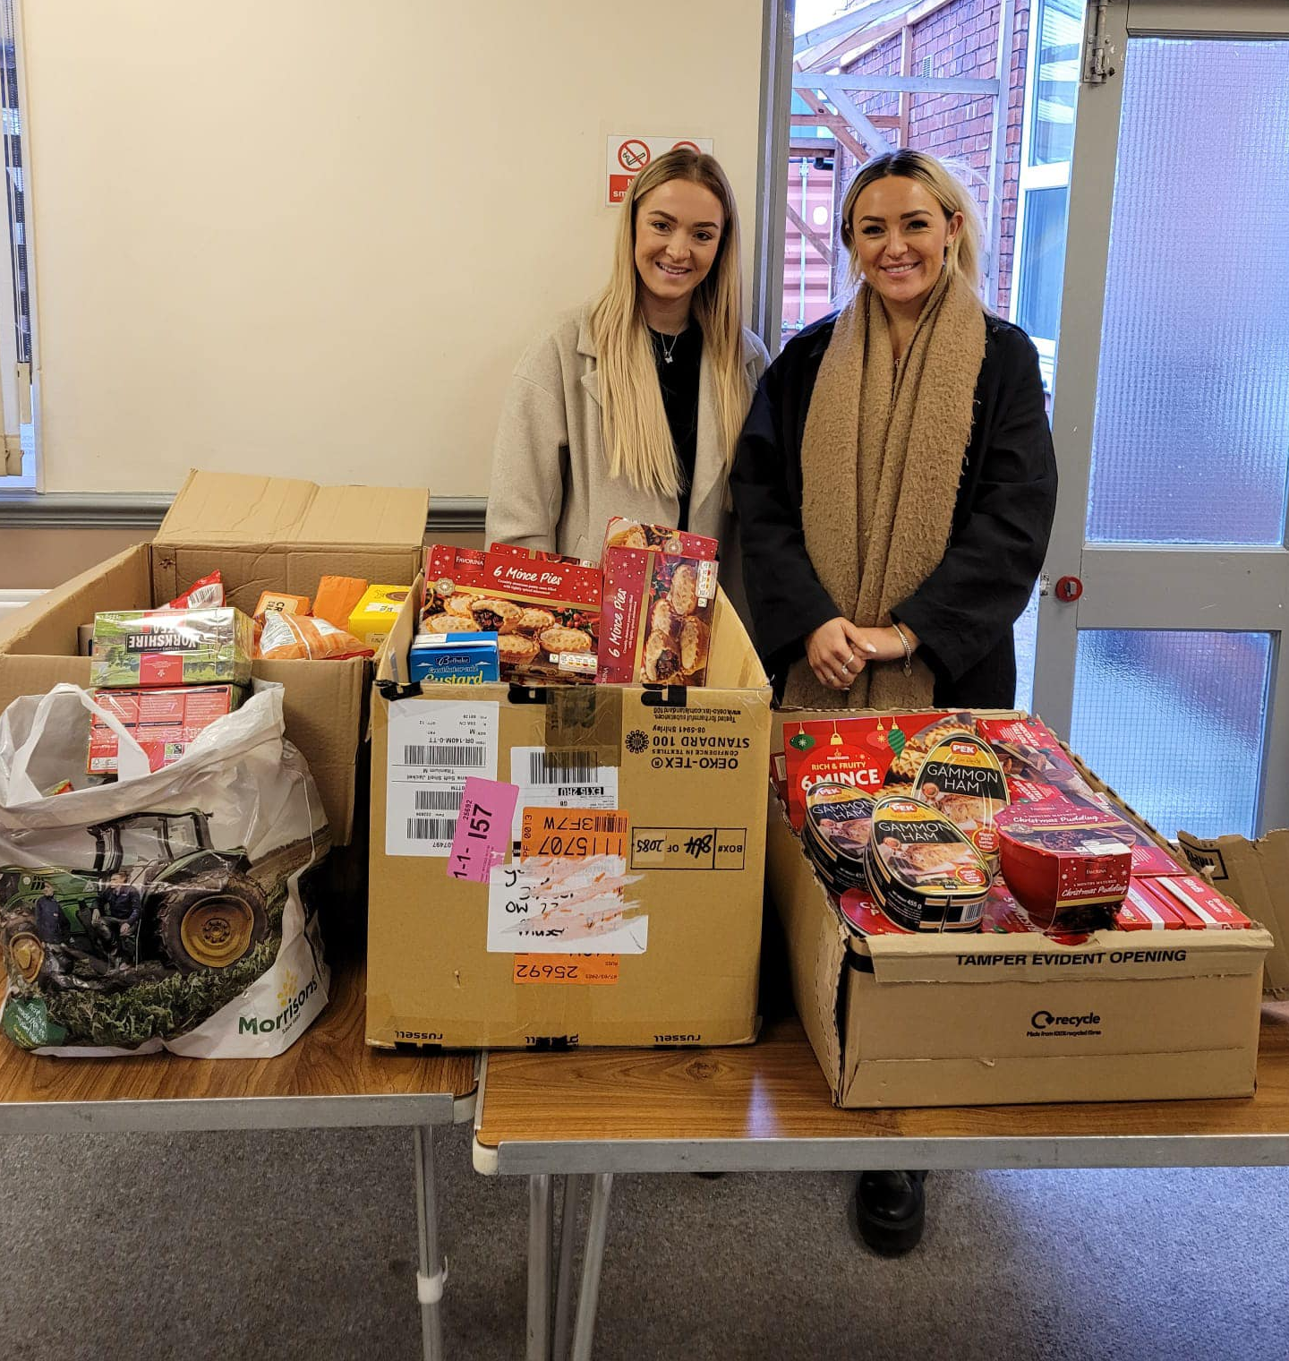
Who needs to come to the Lincoln Community Larder?
People come who find themselves in difficulties because of low pay, being made redundant, money or food being stolen, fire in the home, mental health issues, or people fleeing home for safety.
Lincoln Community Larder is open to all regardless of colour, beliefs or culture.
We help people who are referred to us through agencies such as councils, Citizen’s Advice, churches, doctors and schools.
Welcome donation from local firm Red Rock

Slide 11
Who needs to come to the Lincoln Community Larder?
Real Stories –
Susan and Dennis had four children aged between 6 and 18 years, all at school or college. Dennis worked in sales and the major portion of his salary was made up of commission. Susan had been made redundant 3 months before Dennis became ill. He was off work for 8 weeks. His first couple of pay packets after returning to work comprised just his basic wage which was very low and barely covered the mortgage, council tax and fuel. Susan was very distressed to find herself unable to feed the children unless she borrowed money that she would struggle to pay back. Lincoln Community Larder provided food for two adults and four children and their next problem was carrying all the food home.
Tracey was a single mum with two school aged children. She worked part time but really struggled to make ends meet. She went slightly overdrawn at the bank and the resulting exorbitant bank charges left her with a big hole in her already tight budget. Without a helping hand from the Lincoln Community Larder, Tracey would have been unable to put food on the table.
Jason was a single 19 year old man estranged from his family. He couldn’t find work and lived on a weekly JobSeeker’s Allowance. Jason had a room in a house of multiple occupation – sharing the kitchen and bathroom with the other occupants. After cashing his benefit one week and going shopping, Jason had all his food stolen from the communal kitchen. He had no means of buying more food so was very relieved to receive help from the Lincoln Community Larder to bridge the gap until his next benefit payment was due.

Slide 12
What food do we need?
Most useful donations:-
Jam/Marmalade/Honey
Tinned Fruit
Tinned rice pudding and Tinned Custard
Tinned meats eg. Minced beef, stews, curries, meatballs
Tinned meat eg. Corned beef, spam, ham
Hot dogs
Tinned tuna
Tinned sardines, pilchards etc
UHT Milk, semi skimmed
Tinned Sweetcorn
Tinned carrots
Tinned peas
Tinned tomatoes
Weetabix
Pasta sauces and curry sauce
Small jars of coffee
Tea bags
Sweet biscuits
Angel Delight
Jelly
Meat/Fish Paste
Squash.
Tinned spaghetti and macaroni cheese
Noodle, pot noodles and pasta n sauce
We are of course happy to receive any donations, but please could we ask that the donations are not out of date.

Slide 13
Thank you!
We can't do this without you
Nobody should have to choose between heating and eating, but you can make sure that no one has to by donating food, helping to collect it, or spreading the word.
Find out more about what we do, and why it's so important on our website:
www.lincolnlarder.co.uk
You are very special to us!

